Slide 1
ALTTAI 2017
Experimental research on
role effect of mathematic
examples learning
CCNU
Yang Lei 杨磊

Slide 2
Content
Introduction
Model, method and result
Future works

Slide 3
1. Introduction
Learning is facilitated by interaction with conversational agents that employ effective pedagogical strategies in Intelligent Tutoring Systems (ITS).
One-on-one tutoring system (one tutor and one human learner) have been shown to be effective in multiple learning domains by various research groups. Recently, multiple agents in ITS are increasingly common.

Slide 4
1. Introduction
Pedagogical agents, vicarious learning presenters, peer agents, affectively supportive agents are common types of roles that agents can play in a tutoring system.
The interactive mechanism between these mulitiple angents ,for example ,who said what in a given situation, and it’s impact on learning outcome are still unknown.

Slide 5
1. Introduction
Multinomial processing tree (MPT) models :
MPT models introduced by Riefer and Batchelder (1988)
“Who said what?”(WSW) paradigm:
WSW introduced by Taylor, Fiske, Etcoff, and Ruderman (1978)
Modified “Who said what?”(MWSW) paradigm=MPT+ WSW:
A multinomial model of the “Who said what?” paradigm introduced by Klauer and Wegener in 1998

Slide 6
1. Introduction
The ‘‘Who said what?’’ paradigm is frequently used to measure processes of social categorization which is central to impression formation.
Multinomial processing tree models can be used to to disentangle the relative contributions of the different cognitive processes.
Sex, academic status and other variables have been proven to be important factors in the process.

Slide 7
1. Introduction
In ‘‘Who said what?’’ experiment, participants observe a discussion between members of two or more categories.
In subsequent recognition tests, they are again shown the discussion statements and are then asked to assign each statement to its speaker.
Participant assignment errors can be classified into within-category errors and between-categories errors.

Slide 8
1. Introduction
In the extended version, new items or distracters are also presented in the recogniton test, and participants should decide whether or not the statement occurred in the discussion.
If participants judge the statement old, he or she is required to assign the statement to a speaker in a second step.

Slide 9
1. Introduction
This small modification provides a richer data base, allowing one to disentangle the relative contributions of the different cognitive processes by means of multinomial processing tree models of source discrimination.
In these models, many underlying cognitive processes can be assessed by different parameters, for example, item discrimination, guessing of item status, person memory, person guessing, category memory, reconstructive category guessing and so forth.

Slide 10
1. introduction
Traditional analysis:
Error: error-difference measure
within-category errors
between-categories errors
An important rationale (social categorization):
within-group differences are minimized and between-group differences are exaggerated, leading one to expect that the strength of categorization process is reflected in the differential likelihood of confusions within versus between categories.
K. C. Klauer and I. Wegener, Unraveling social categorization in the “Who said What?” paradigm, 1998
Notes:
An important rationale for this practice has been the traditional assumption that as a result of social categorization, within-group differences …

Slide 11
1. Introduction
Conventional Approach:
the difference of within-category and between-categories errors as dependent variable, or equivalently conducted analyses of variance (ANOVAs).
The error-difference measure have easy three confounded processes:
Item discriminations
Person discriminations
Category discriminations
Expectancy-base guessing
The objective of MWSW paradigm is to propose and validate a substantive model of the processes involved in the “Who said what?” paradigm, that aims at disentangling the separate contributions of these different process.

Slide 12
2. Model, method and result
2.1 theory hypothesis
Hypothesis：
Memory (parameter):
statements by the teacher saying are easier to remember than by students
statements with script present are easier to remember
than with random present.
Guessing (parameter) (don’t verify in the present)
positive examples tends to guess by teacher
negative examples is more likely to guess by students
Notes:
According to theoretical analysis, combining pedagogy, the following hypothesis is proposed:

Slide 13
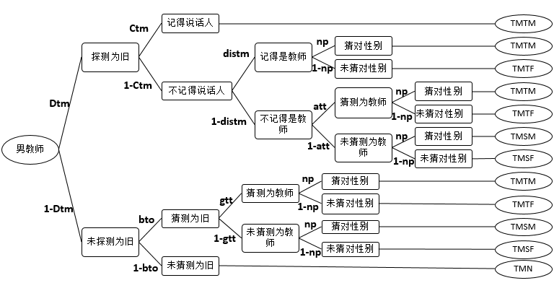
2. Model, method and result
2.2 Model and Data Matrix
Statements made by the male teacher (TM) category
7 parameters: Dtm, ctm, distm, att, bto, gtt, np;
5 observe categories: TMTM, TMTF, TMSM, TMSF, TMN;

Slide 14
2. Model, method and result
2.2 Model and Data Matrix
Multinomial processing tree model (Riefer & Batehelder 1988, Hu & Batchelder 1994, etc) describes participants’ responses by means of the processes of item discrimination, person discrimination, and category discrimination as well as three guessing processes.
The MWSW modified model has:
5 trees (sources category: male teacher, female teacher; male student, female student; new item/ distracter )
25 observed categories ( TMTM, TMTF, TMSM, TMSF, TMN; TFTM, TFTF, TFSM, TFSF, TFN; SMTM, SMTF, SMSM, SMSF, SMN; SFTM, SFTF, SFSM, SFSF, SFN; NTM, NTF, NSM, NSF, NN )
22 parameters (ass, att, bno, bso, bto, csf, csm, ctf, ctm, dissf, dissm, distf, distm, Dsf, Dsm, Dtf, Dtm, Dn, gnt, gss, gtt, np )

Slide 15
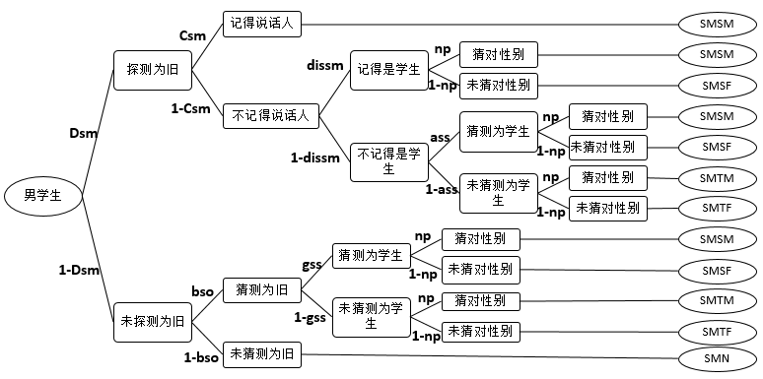
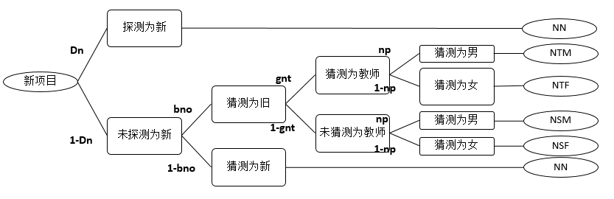
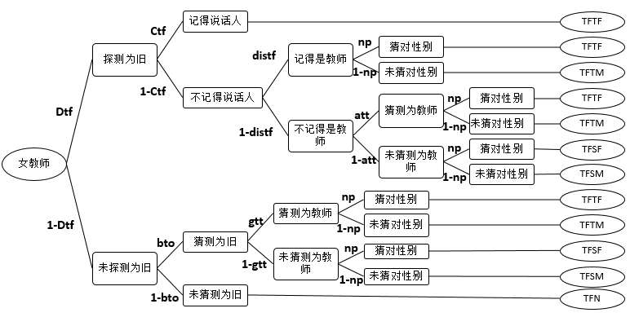
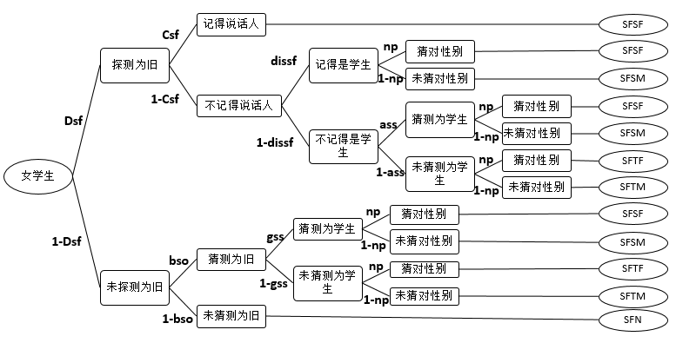
2. Model, method and result
2.2 Model and Data Matrix
female teacher;
5 trees (sources category: male teacher,
male student,
female student;
new item/ distracter )

Slide 16
2. Model, method and result
2.2 Model and Data Matrix
22 parameters (ass, att, bno, bso, bto, csf, csm, ctf, ctm, dissf, dissm, distf, distm, Dsf, Dsm, Dtf, Dtm, Dn, gnt, gss, gtt, np )
memory parameters:
Dsf, Dsm, Dtf, Dtm, Dn (Item discrimination)
csf, csm, ctf, ctm (Person discrimination)
dissf, dissm, distf, distm (Category discrimination)
Guessing parameters:
ass, att, gnt, gss, gtt; np
Bias parameters:
bno, bso, bto

Slide 17
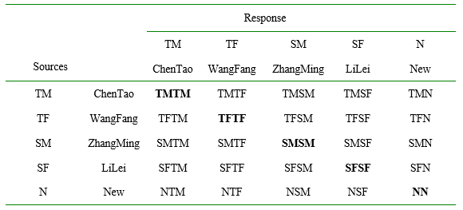
2. Model, method and result
2.2 Model and Data Matrix
Note: T: Teacher; S: Student; M: Male; F: Female; N: New Item/Distracter
Means : TMSF: the statement from the Male Teacher was assigned to the wrong speaker as a Female Student.

Slide 18
2. Model, method and result
2.2 Model and Data Matrix
between-categories errors
within-category errors
correct
Note: T: Teacher; S: Student; M: Male; F: Female; N: New Item/Distracter Means : TMSF: the statement from the Male Teacher was assigned to the wrong speaker as a Female Student.

Slide 19
2. Model, method and result
2.2 Model and Data Matrix
Note: T: Teacher; S: Student; M: Male; F: Female; N: New Item/Distracter Means : TMSF: the statement from the male teacher was assigned to the wrong speaker as a female student. ?
Dtm*ctm +
Dtm*(1-ctm)*distm*np
Pr{TMTM} =
+Dtm*(1-ctm)*(1-distm)*a*np
+ (1-Dtm)*bto*gtt*np

Slide 20
2. Model, method and result
2.2 Model and Data Matrix
Source: Male Teacher (TM) 5 equations
Pr{TMN} = (1-D)*(1-b)
Pr{TMSF} = D*(1-ct)*(1-dist)*(1-a)*(1-np) + (1-D)*b*(1-a)*(1-np)
Pr{TMSM} = D*(1-ct)*(1-dist)*(1-a)*np + (1-D)*b*(1-a)*np
Pr{TMTF} = D*(1-ct)*dist*(1-np) + D*(1-ct)*(1-dist)*a*(1-np) + (1-D)*b*a*(1-np)
Pr{TMTM} = D*ct + D*(1-ct)*dist*np + D*(1-ct)*(1-dist)*a*np + (1-D)*b*a*np
Source: Female Teacher (TF), Male Student (SM), Female Student (SF),
Each source has 5 equations
Total 25 equations /observe categories

Slide 21
2. Model, method and result
2.2 Model and Data Matrix
the degree of freedom:
df= NOC- NOT - (NOP-NOPCP)
NOC = # of Observed categories
NOT = # of Trees
NOP = # of Parameters
NOPCP = # of Parameters Set as Constant Probability
The degree of freedom of the MWSW model:
df= NOC- NOT - (NOP-NOPCP)=25 - 5 - ( 22 - 0 ) = -2
Unrecognized model
Constraint parameter (e.g.:D=Dsf=Dsm=Dtf=Dtm=Dn, a=ass=att=gnt=gss=gtt, b=bno=bso=bto, cs=csf=csm, ct=ctf=ctm, diss=dissf= dissm, dist=distf=distm, np=0.5 )

Slide 22
2. Model, method and result
2.3 Method
Participants:
62 male and female students from the science and technology college.
Pool of statements:
The 48 examples, including 8 knowledge points of elementary mathematic, with each point containing 6 examples which consist of 3 positive examples and 3 negative examples, thus, are made up of 24 positive examples and 24 negative examples.
Study phase: Six knowledge points which include 2 positive and negative examples were random selected from 8 knowledge points.
Test phase: total 48 examples were randomly presented.
(old: 12 positive and 12 negative examples; 24 new items)

Slide 23
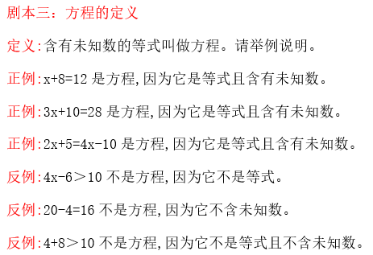
2. Model, method and result
2.3 Method
Examples:
Randomly presented
2 of the 3.

Slide 24



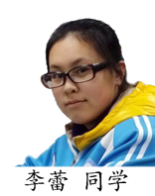
2. Model, method and result
2.3 Method
Roles:
male teacher, female teacher, male student, female student

Slide 25
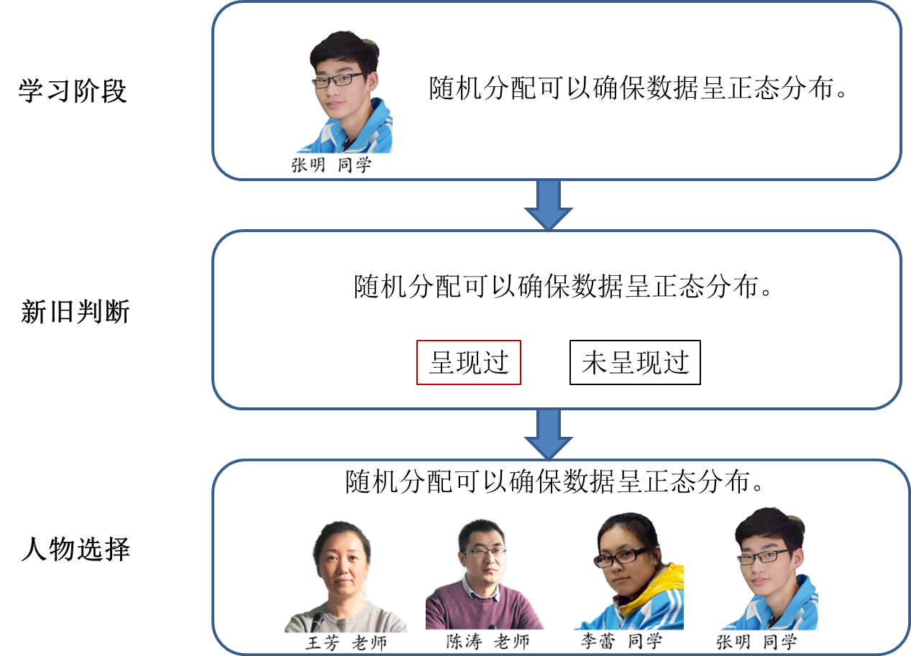
2. Model, method and result
2.3 Method
Procedure: study phase and test phase
study phase
test phase

Slide 26
2. Model, method and result
2.3 Method
Experiments:
Experiment 1: Examples were presented at random.
Experiment 2: Examples were presented at script.
Random: Twelve positive and 12 negative examples are presented randomly.
Script: Six knowledge points are presented randomly one by one, and each knowledge point present randomly 2 positive and 2 negative examples.
To evaluate the role effect of virtual agents, two experiments, in which learning content was presented in random and organized way separately were done.

Slide 27
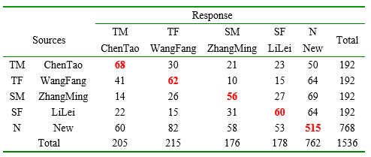
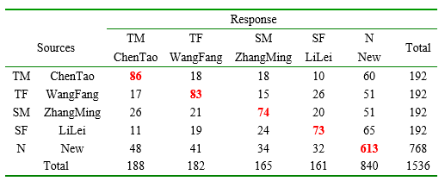
2. Model, method and result
2.4 Results
Data matrix of
experiments:
Experiment 1:
Random present
Experiment 2:
Script present

Slide 28
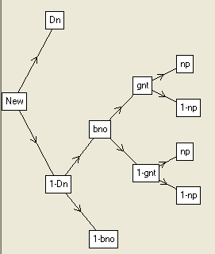
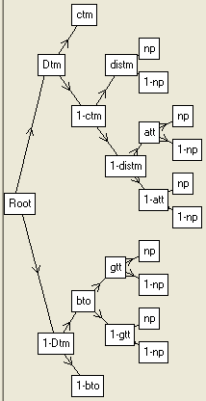
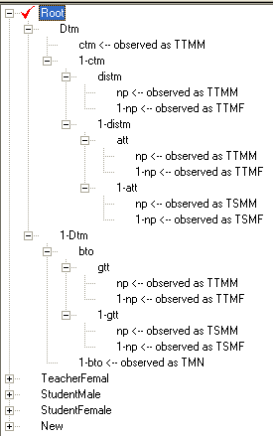
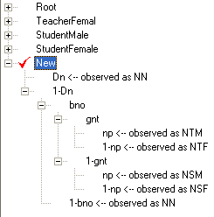
2. Model, method and result
2.4 Results
Data analysis software:
GPT，MPTinR

Slide 29
2. Model, method and result
2.4 Results
For the model analyses, we assumed to constraint conditions.
Constraint parameter : (e.g.)
D=Dsf=Dsm=Dtf=Dtm=Dn, item discrimination parameter
a=ass=att=gnt=gss=gtt, probability of guessing category
b=bno=bso=bto, probability of guessing a statement is old
cs=csf=csm, person discrimination parameter of students*
ct=ctf=ctm, person discrimination parameter of teachers*
diss=dissf= dissm, category discrimination parameter of students
dist=distf=distm, category discrimination parameter of teachers

Slide 30
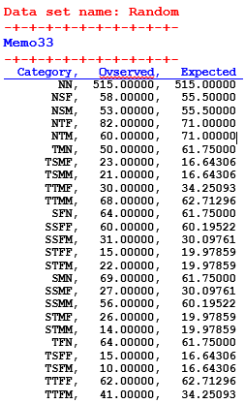
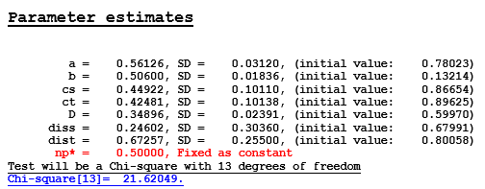
2. Model, method and result
2.4 Results
Data set name: Random
an satisfied goodness of fit (G2 = 21.62, df = 13, p =.062)

Slide 31
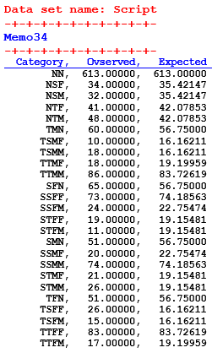
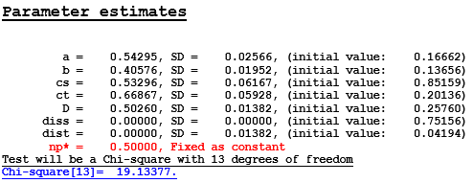
2. Model, method and result
2.4 Results
Data set name: Script
an satisfied goodness of fit (G2 = 19.13, df = 13, p =0.12)

Slide 32
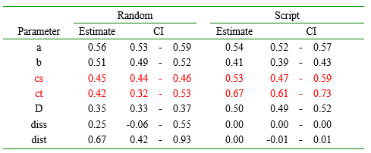
2. Model, method and result
2.4 Results
As can be seen, person discrimination ct/cs for teachers /students speakers were much increased in the group with Script.
Item discrimination parameter D was increased too.
But the categorization parameters diss/dist are not significantly larger than zero.

Slide 33
3. Future works
At present, the experiment is only to simulate the AutoTutor system in E-Prime, and positive and negative examples data were overall analyzed.
The next step will be to do experiments on the SKO (Shareable Knowledge Objects) with middle school students.
The data of positive and negative examples were analyzed separately from the participant gender and role gender data.
(verify hypotheses): Guessing (parameter):
positive examples tends to guess by teacher
negative examples is more likely to guess by students

Slide 34

Thank You !

